Slide 1
Chinese Citizens Find Ways to Circumvent Covid-19 Censorship
Mary Huber
https://medium.com/good-systems/chinese-citizens-find-ways-to-circumvent-covid-19-censorship-e8934e978158
Platforms, Community Archives and Remembering the Pandemic
Amelia Acker
https://globalmedia.mit.edu/2020/06/09/platforms-community-archives-and-remembering-the-pandemic
Presented by Peter Foytik
12/3/2020

Slide 2
Outline
Alternative platforms used for archiving
Chinese censorship
Chinese censorship Covid-19
Github and Chinese Covid-19
Challenges moving forward

Slide 3
Alternative platforms used by communities to archive
Twitter*
Instagram* (Facebook owned)
Google drive*
Dropbox
Github (Microsoft owned)
Telegram
Platforms are typically chosen for access and ease of use
(*) Source blocked by China https://en.wikipedia.org/wiki/List_of_websites_blocked_in_mainland_China

Slide 4

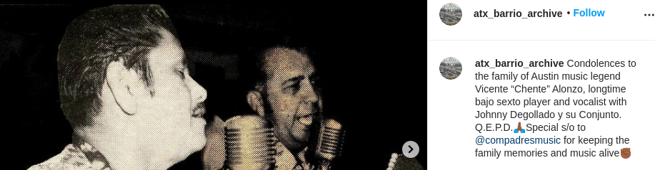
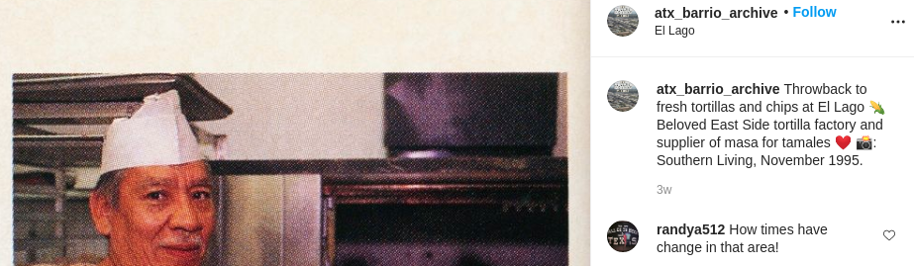
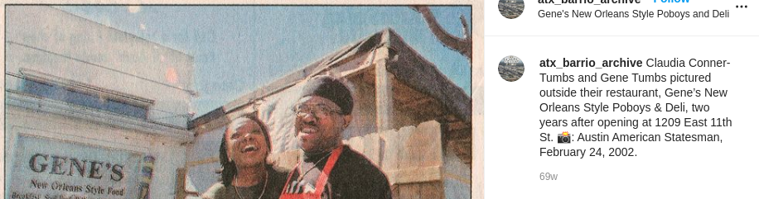
ATX Barrio Archive celebrates Austin’s black and brown neighborhoods and reaches community members using Instagram
https://www.instagram.com/atx_barrio_archive/?hl=en

Slide 5
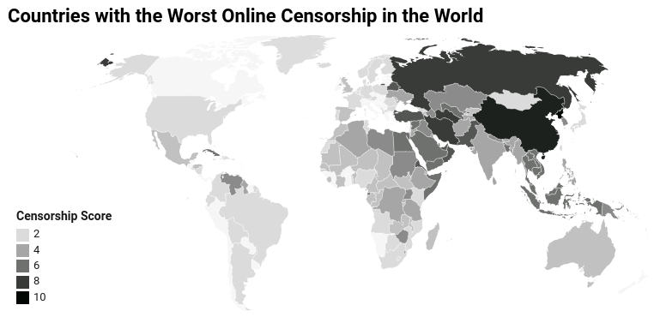
Internet access restrictions across the world
https://www.comparitech.com/blog/vpn-privacy/internet-censorship-map

Slide 6
Chinese censorship
Implemented by the Peoples Republic of China's ruling party, the Chinese Communist Party
Chinese Government produced whitepaper describing the control of Internet censorship within the country of China in 2010
"Laws and regulations clearly prohibit the spread of information that contains content subverting state power, undermining national unity [or] infringing upon national honour and interests,"
China still maintains that its people have unfettered access to the Internet. "Chinese citizens fully enjoy freedom of speech on the Internet,"
https://web.archive.org/web/20190701023627/http://news.bbc.co.uk/2/hi/8727647.stm

Slide 7
Media censored by the Chinese government
Television
Print media
Radio
Film
Theater
Text messaging
Instant messaging
Video games
Literature
Internet

Slide 8
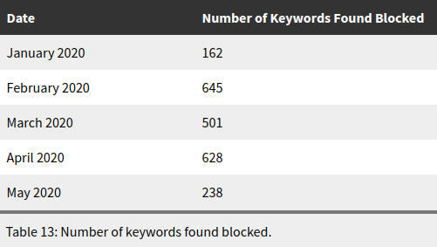
Chinese historically censors based on keyword searches, Covid-19 censorship facilitated by keyword searches on platforms
https://citizenlab.ca/2020/08/censored-contagion-ii-a-timeline-of-information-control-on-chinese-social-media-during-covid-19

Slide 9
Github as platform to circumvent censorship
Chinese government works and trades with Microsoft (owner of Github)
Chinese software developers use Github regularly
Source version control of software projects
Access and build open-sourced tools
Participate with the world in software development

Slide 10
Difficulty for China to censor content on Github
Cannot block service (developers need access)
To remove specific content must convince Microsoft to remove it
The ability and ease of distribution of content to communities
The ability and ease to fork and clone repos

Slide 11
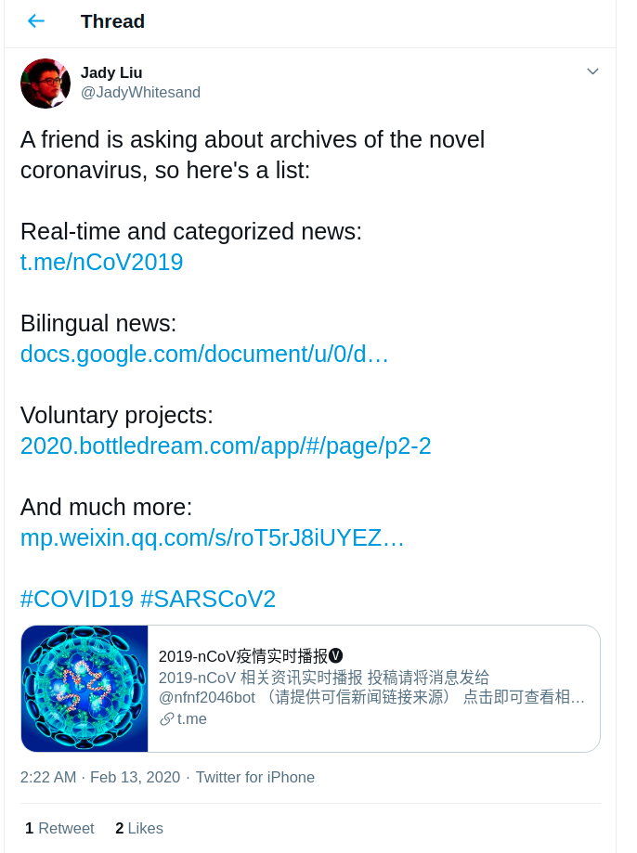
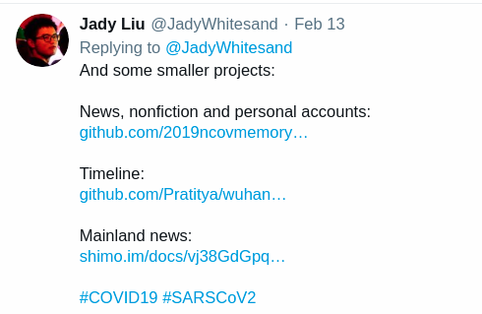
Sources of archives of the novel coronavirus from Jady Liu, a freelance journalist in China
https://twitter.com/JadyWhitesand/status/1227855444749758464

Slide 12
China Covid-19 Github archives
2 repos, both of which popped up in late January at the crux of the COVID-19 pandemic in China.
/nCovMemory
https://github.com/2019ncovmemory/nCovMemory (Taken down April 25 2020)
https://2019ncovmemory.github.io/nCovMemory/ (github pages for repo)
https://github.com/memeshk/nCovMemory
https://github.com/memeshk/nCovMemory-en
/Wuhan2019
https://github.com/lestweforget/wuhan2019

Slide 13
/2019nCovMemory archive availability for the Github repo and the github.io page
curl -s http://memgator.cs.odu.edu/timemap/link/https://https://github.com/2019ncovmemory/nCovMemory | grep datetime | awk '{print $1}' | awk -v FS=/ '{print $3}' | sort | uniq -c | sort –n
268 web.archive.org
curl –s http://memgator.cs.odu.edu/timemap/link/https://2019ncovmemory.github.io/nCovMemory/ | grep datetime | awk '{print $1}' | awk -v FS=/ '{print $3}' | sort | uniq -c | sort –n
3 wayback.archive-it.org
10 archive.md
148 web.archive.org

Slide 14
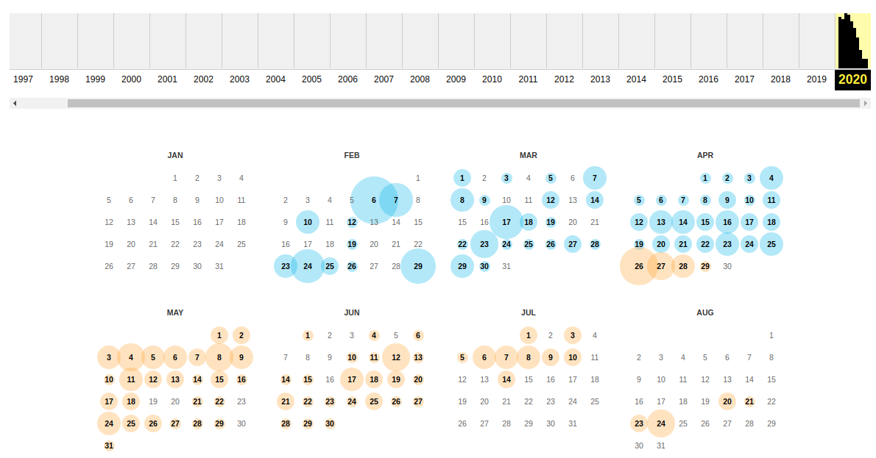
/nCovMemory summary from web.archive.org
http://web.archive.org/web/*/https://github.com/2019ncovmemory/nCoVMemory

Slide 15
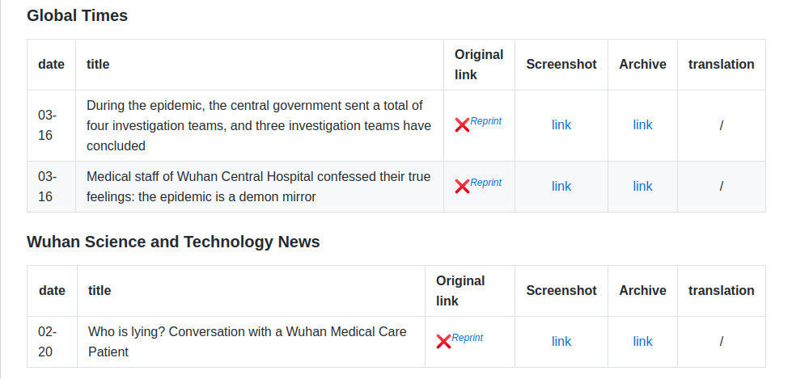
Example of content in nCovMemory repo from Wayback Machine
http://web.archive.org/web/20200425044035if_/https://github.com/2019ncovmemory/nCoVMemory#%E7%A1%95%E4%BF%8A%E5%AE%B6%E4%B9%A6

Slide 16
URI-R and URI-M for the links in the Wayback Machine archive
Original link
URI-R: http://bbs1.people.com.cn/post/2/0/0/174922266.html
URI-M: http://web.archive.org/web/20200425044035/http://bbs1.people.com.cn/post/2/0/0/174922266.html
Screenshot
URI-R: https://github.com/2019ncovmemory/nCovMemory/blob/master/archive/jpg/3615.jpg
URI-M: http://web.archive.org/web/20200425044035/https://github.com/2019ncovmemory/nCovMemory/blob/master/archive/jpg/3615.jpg
Archive
URI-R: http://archive.vn/cjNVI
URI-M: http://web.archive.org/web/20200425044035/http://archive.vn/cjNVI

Slide 17
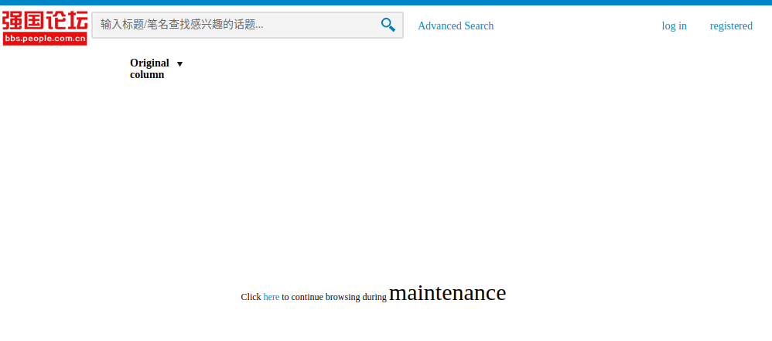
URI-R from Wuhan Science and Technology News (Live) currently shows the article has been removed
URI-R: http://bbs1.people.com.cn/post/2/0/0/174922266.html

Slide 18
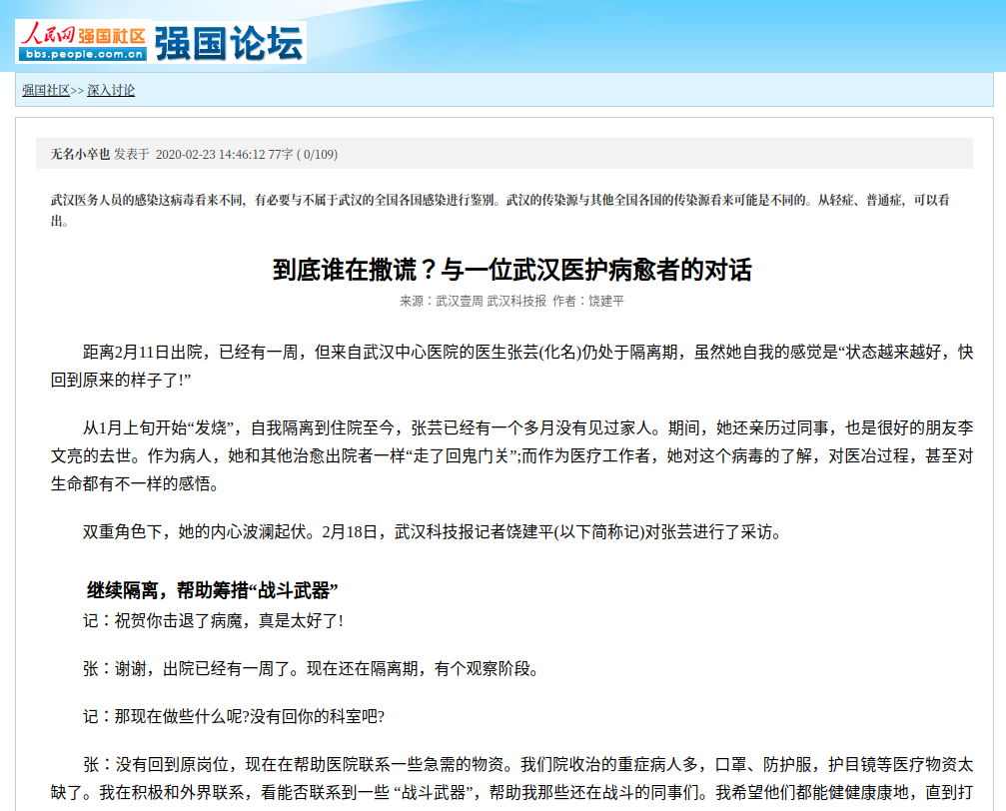
URI-M link from Wuhan Science and Technology News provides the archived version of the article
URI-M: http://web.archive.org/web/20200405194928/http://bbs1.people.com.cn/post/2/0/0/174922266.html

Slide 19
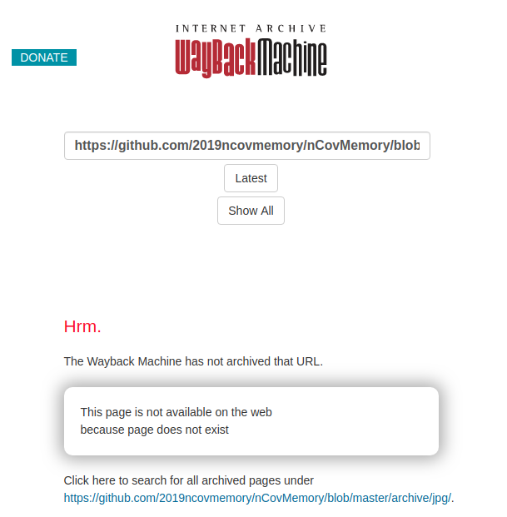
URI-M Screenshot link from Wuhan Science and Technology News (Archive) is linked but not archived
URI-M:
http://web.archive.org/web/20200425044035/https://github.com/2019ncovmemory/nCovMemory/blob/master/archive/jpg/3615.jpg

Slide 20
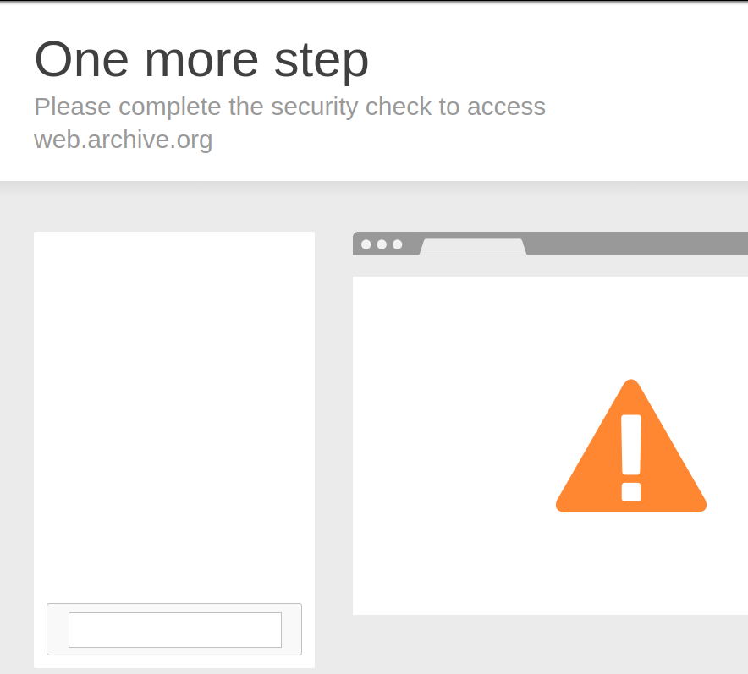
URI-M Archive link from Wuhan Science and Technology News points to archive.today but shows archive of CAPTCHA request
URI-M: http://web.archive.org/web/20200405200819/http://archive.vn/cjNVI

Slide 21
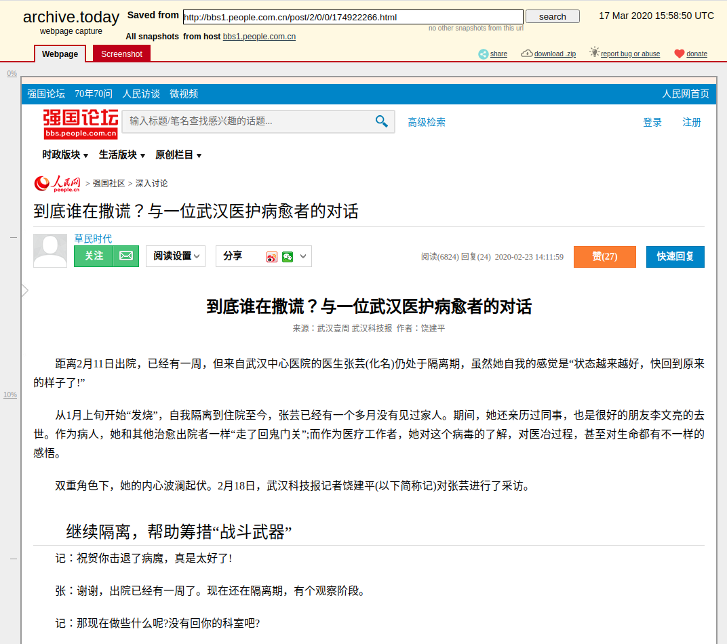
The archive.today shortened link works it just needs to be extracted from the URI-M of the Wayback Machine
URI-M Short:
http://archive.vn/cjNVI
URI-M Long:
http://archive.today/2020.03.17-155850/http://bbs1.people.com.cn/post/2/0/0/174922266.html

Slide 22
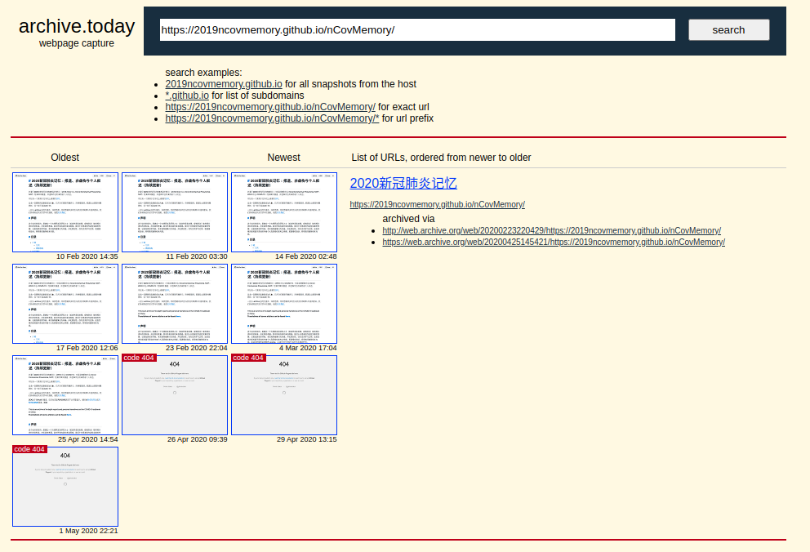
The archive on Wayback Machine is more complete comparing the media and personal narrative sources
Counts | Wayback Machine | archive.today
Media Sources | 91 | 44
Personal Narrative | 115 | 19
http://archive.is/https://2019ncovmemory.github.io/nCovMemory/

Slide 23
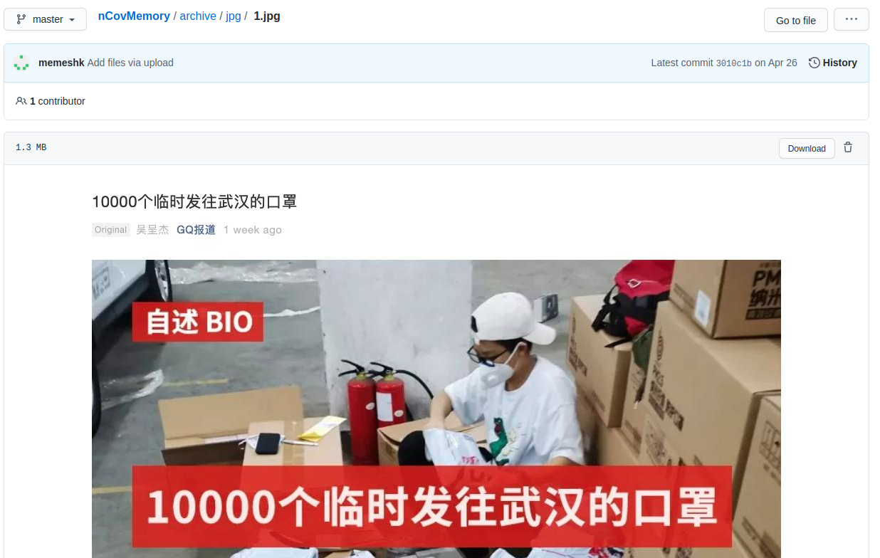
To avoid keyword search much of the archived material is images or PDF to avoid text searchable content referred to as "screensampling"
Screensampling creates a memetic abstraction from the original source by converting a web resource into an image, resulting in a transmedia transformation of the existing content.
- Amelia Acker
https://misinforeview.hks.harvard.edu/article/the-weaponization-of-web-archives-data-craft-and-covid-19-publics
URI-R:
https://github.com/memeshk/nCovMemory/blob/master/archive/jpg/1.jpg

Slide 24
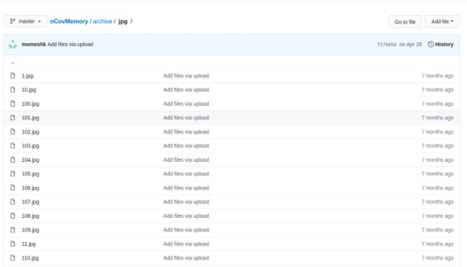
Cloned github repo of nCovMemory's archive/jpg folder has 700 images of articles
URI-R:
https://github.com/memeshk/nCovMemory/tree/master/archive/jpg

Slide 25
Wuhan2019 Github from lestweforget states (with Google Translate):
Around April 17, the epidemic situation and public opinion: The Wuhan pneumonia timeline TIMELINE project was suspended and disappeared afterwards.
During the same period, 2019ncovmemory stopped updating, after which the entire project disappeared
Around April 23, volunteers Chen Mei, Cai Wei, and their girlfriends from Endpoint Star (a website backing up articles that were deleted by the authorities) were reported to be under “residential surveillance in designated residences,” which is house arrest in a secular sense.
The above three people have not been free yet.
https://github.com/lestweforget/wuhan2019

Slide 26
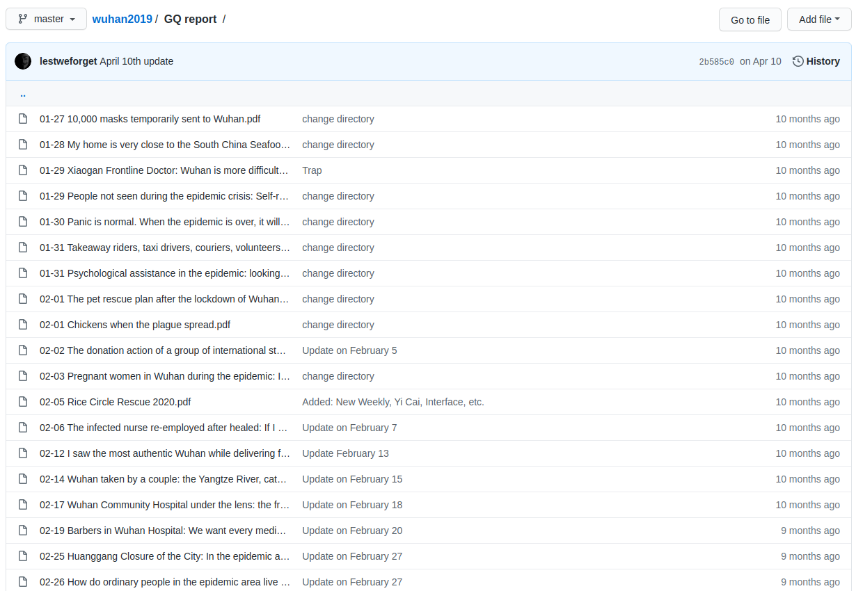
Wuhan2019 focuses on pdf copies of all media associated with Covid-19 in China
42 directories each associated with a news outlet or journalism organization
Each directory containing dated PDFs of news related to Covid from each organization

Slide 27
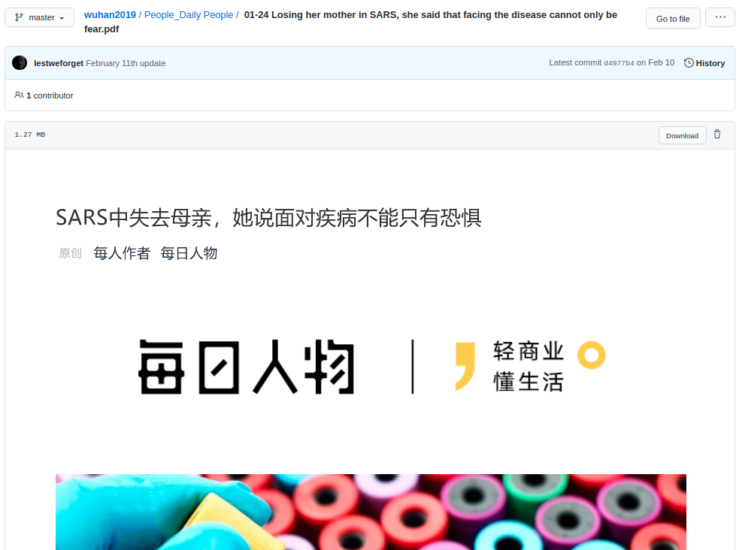
PDF representation is like the JPEG
Both prevent keyord searches
Both also make it difficult to auto-translate with Google
Resolution looks similar in both cases
URI-M https://github.com/lestweforget/wuhan2019/blob/master/%E4%BA%BA%E7%89%A9_%E6%AF%8F%E6%97%A5%E4%BA%BA%E7%89%A9/01-24%20SARS%E4%B8%AD%E5%A4%B1%E5%8E%BB%E6%AF%8D%E4%BA%B2%EF%BC%8C%E5%A5%B9%E8%AF%B4%E9%9D%A2%E5%AF%B9%E7%96%BE%E7%97%85%E4%B8%8D%E8%83%BD%E5%8F%AA%E6%9C%89%E6%81%90%E6%83%A7.pdf

Slide 28
State of repos today
/Wuhan2019, is still accessible online but released a statement at the end of April that it would no longer accept new articles because of personal threats and the fears associated with long-term preservation.
/2019nCovMemory is taken down with only archives of it partially preserved at web.archive.org and archive.today
Many clones of the repo exist on Github providing collectively a more complete archive
The most complete clone was not archived on Wayback Machine (archived it just in case)

Slide 29
Future and challenges of alternative platform archives
Github was not designed for archiving, it was designed for source version control in community-based environment
Users determined this was a great alternative to support the dissimenation of censored content as images or PDFs
The use of social media to archive community content is appealing because of its simplicity, market adoption, and production quality
Because of social media platforms popularity and profit driven enterprises
Users should be careful of political control over the companies that hold the archives
The centralized nature of the social media platforms and increasing legislative regulation indicate more government control over the content of these sites
Historically it seems the best means of archive is to spread the information everywhere
Github was built for this and allows this action within its platform
Forking and cloning

